Slide 1
MAJOR PROJECT REPORT TIME SERIES ANALYSIS OF STOCK MARKET (AMAZON STOCKS)
Mentor: Dr. Sekhar Mandal
Submitted by:
2021CSB066 - K Ashrith
2021CSB117 - Boola Likhith
2021CSB119 – Mukara Issac

Slide 2
Table of Contents:
Abstract
Introduction
Description of Data set
- Time Series plots
- ACF plot
- Checking for missing values
- Splitting data into train & test
Check for Stationarity
- Visual check
- ADF test
- First Order Differencing
Time Series Decomposition
- Additive
- Multiplicative
Holt-Winter & other forecasting Methods
Auto regressive model
ARMA Model - Auto-ARIMA -SARIMA
Picking the best Model
Conclusion
References

Slide 3
Objective: This study focuses on time series analysis using stock price data for Amazon. The objective is to apply various time series models, including Average, Naïve, Drift, Simple Exponential Smoothing, Holt Linear, Holt-Winters, Linear Regression, and Auto Regressive Moving Average (ARMA), to forecast future stock prices.
Motivation: Amazon’s stock performance serves as a critical indicator of the company's market position and overall economic influence. Accurate forecasting of stock prices is essential for investors, financial analysts, and stakeholders to make informed decisions. In this project, we aim to predict Amazon's stock prices using a range of time series models, evaluating their accuracy and determining which model best captures the underlying trends for reliable future forecasting.

Slide 4
Description of Dataset:
The dataset used for this analysis consists of monthly stock prices for Amazon. The key variables in the dataset are:
Date: The time index representing each month in the series.
Open: The opening stock price of Amazon at the start of each trading day.
Close: The closing stock price at the end of each trading day.
High: The highest stock price reached during the day.
Low: The lowest stock price recorded during the day.
Volume: The number of shares traded during the day.

Slide 5
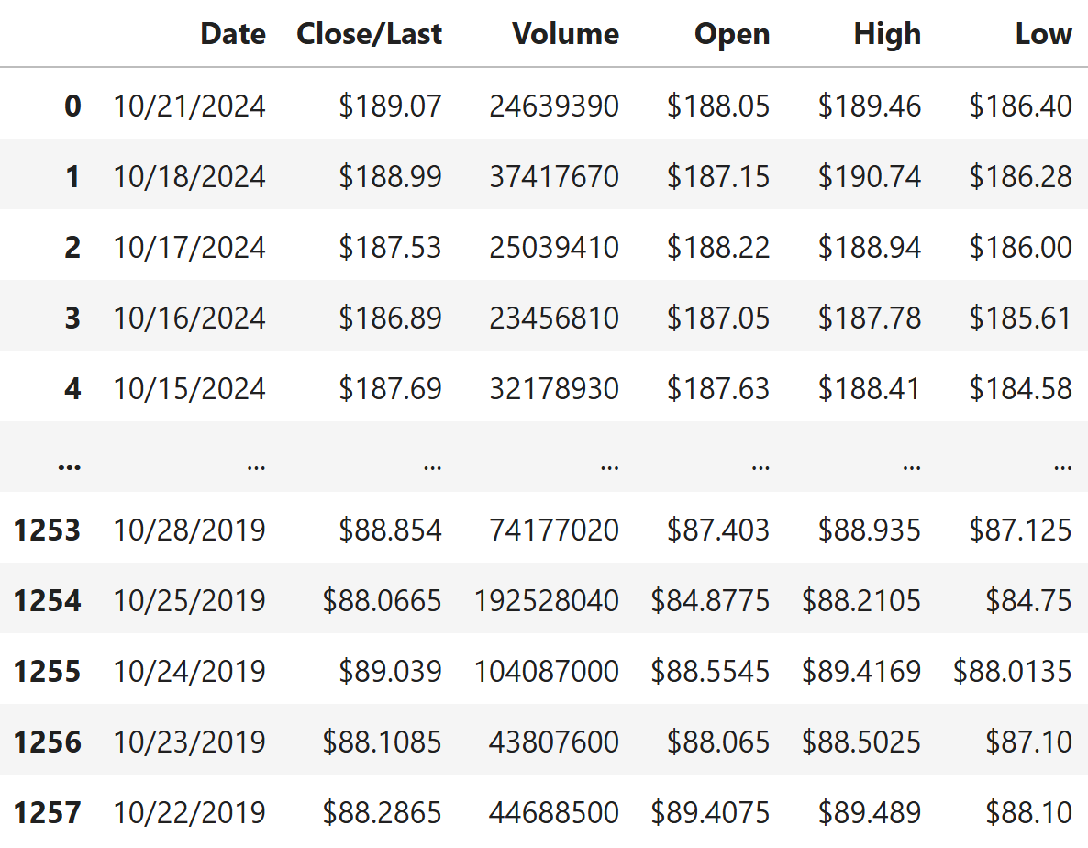
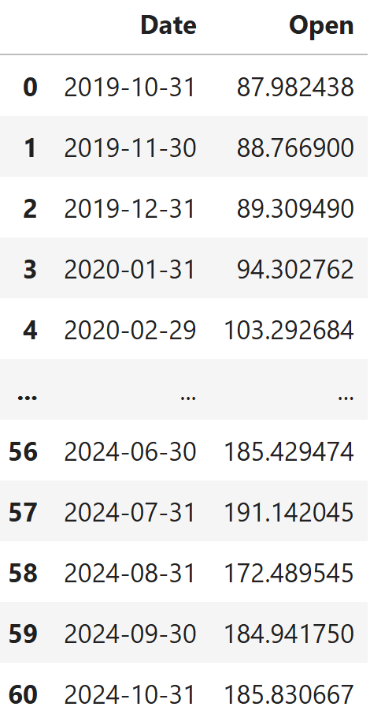
Preprocessing Data:
Converted the Date column from string to datetime format for time-based operations.
Removed the currency symbol ($) from Close/Last, Open, High, and Low columns and converted them to float values. Checking and addressing the null values in the data.
Selected only the Date and Open columns for analysis.
Set the Date column as the index to facilitate time series operations.
Resampled the data to a monthly frequency by calculating the mean of the Open prices for each month.
Reset the index to maintain a clean DataFrame structure.

Slide 6
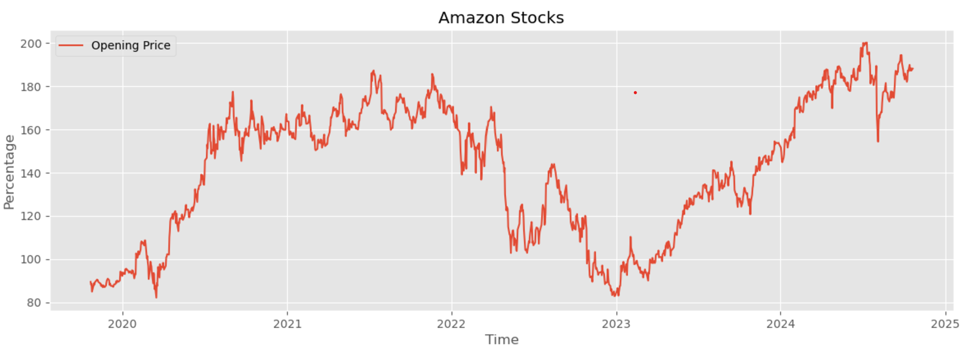
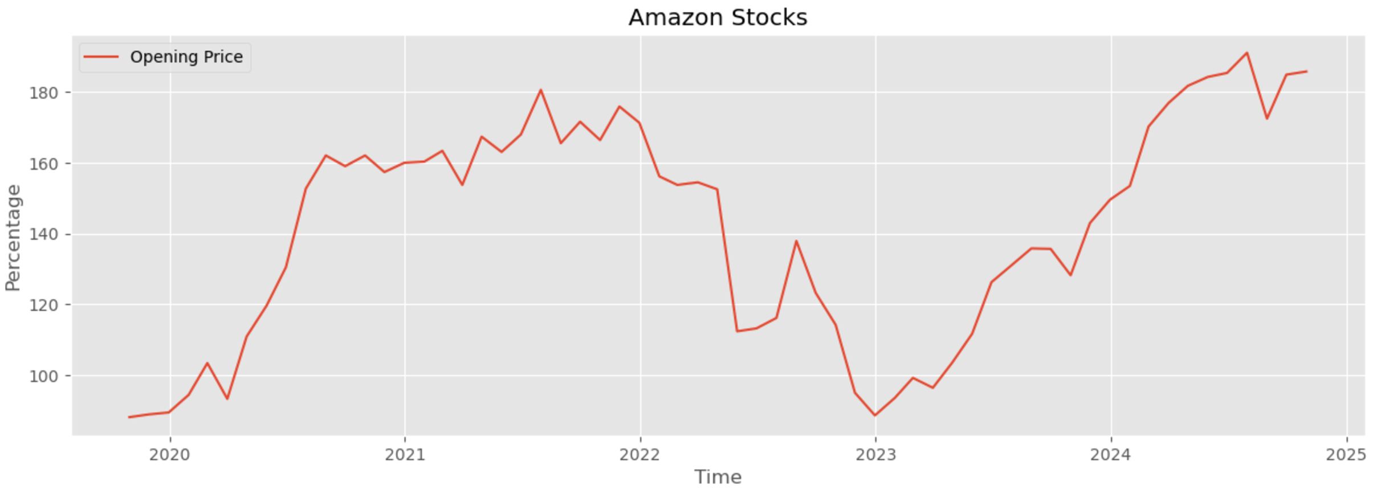
Daily Opening range vs Time
Monthly Opening range vs Time

Slide 7
ACF of Amazon Opening Stocks:
The Autocorrelation Function (ACF) measures the correlation between the current value of a time series and its past values at various lags. It helps to identify patterns and the strength of the relationship between observations over time.
In the ACF plot for Amazon's opening stock prices, we observe significant oscillations in correlation across different lags.
Partial Autocorrelation Function (PACF)
The Partial Autocorrelation Function (PACF) measures the correlation between a time series and its lagged values after removing the influence of intermediate lags. Unlike the Autocorrelation Function (ACF), which considers the total correlation at each lag, PACF isolates the direct effect of a specific lag.

Slide 8
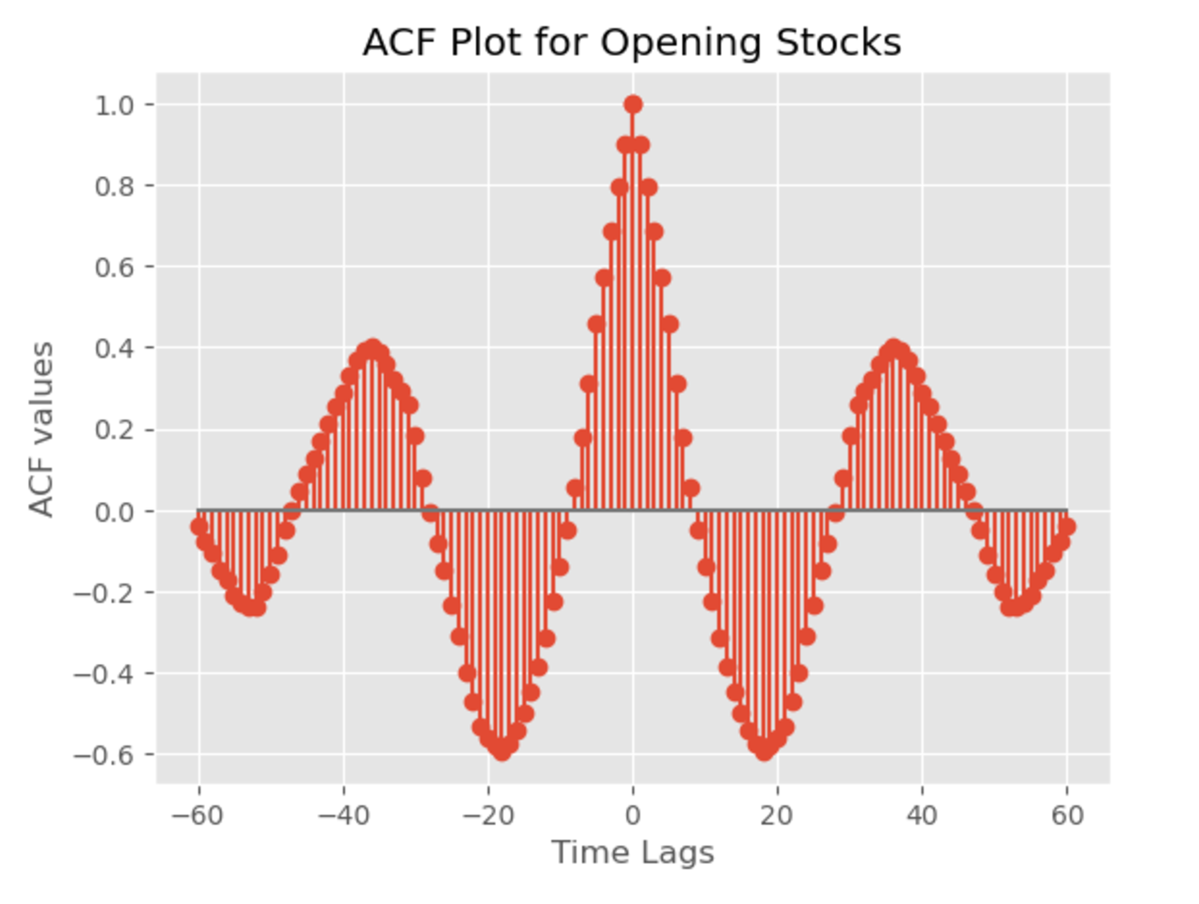
Positive and Negative Peaks:
The plot shows clear periodic fluctuations, with strong positive and negative correlations at regular intervals. This indicates a cyclical pattern in stock prices.
Decaying Pattern:
The autocorrelation values diminish gradually with increasing lags, signifying that the correlation weakens over time. This suggests that recent values are more strongly correlated than distant ones, implying more reliable short-term forecasts than long-term ones.
This behavior indicates that the opening stock prices have a strong dependency on past values within shorter time frames, making short-term predictions more accurate compared to long-term forecasts.

Slide 9
Stationarity Analysis:
For accurate forecasting in time series models, stationarity is a critical prerequisite. A time series is considered stationary if its fundamental statistics, such as mean and variance, remain constant over time. There are two main methods to determine the stationarity of the dataset:
1. Visual Inspection
By plotting the time series data, we can visually assess whether the mean and variance remain constant or vary over time.
In the graph below, the red line represents the Amazon Opening Stock data, the blue line indicates the mean, and the green line shows the variance.
Observation: Both the mean and variance exhibit significant fluctuations over time, indicating non-stationarity. However, visual inspection can be subjective and should be supplemented by statistical tests.

Slide 10
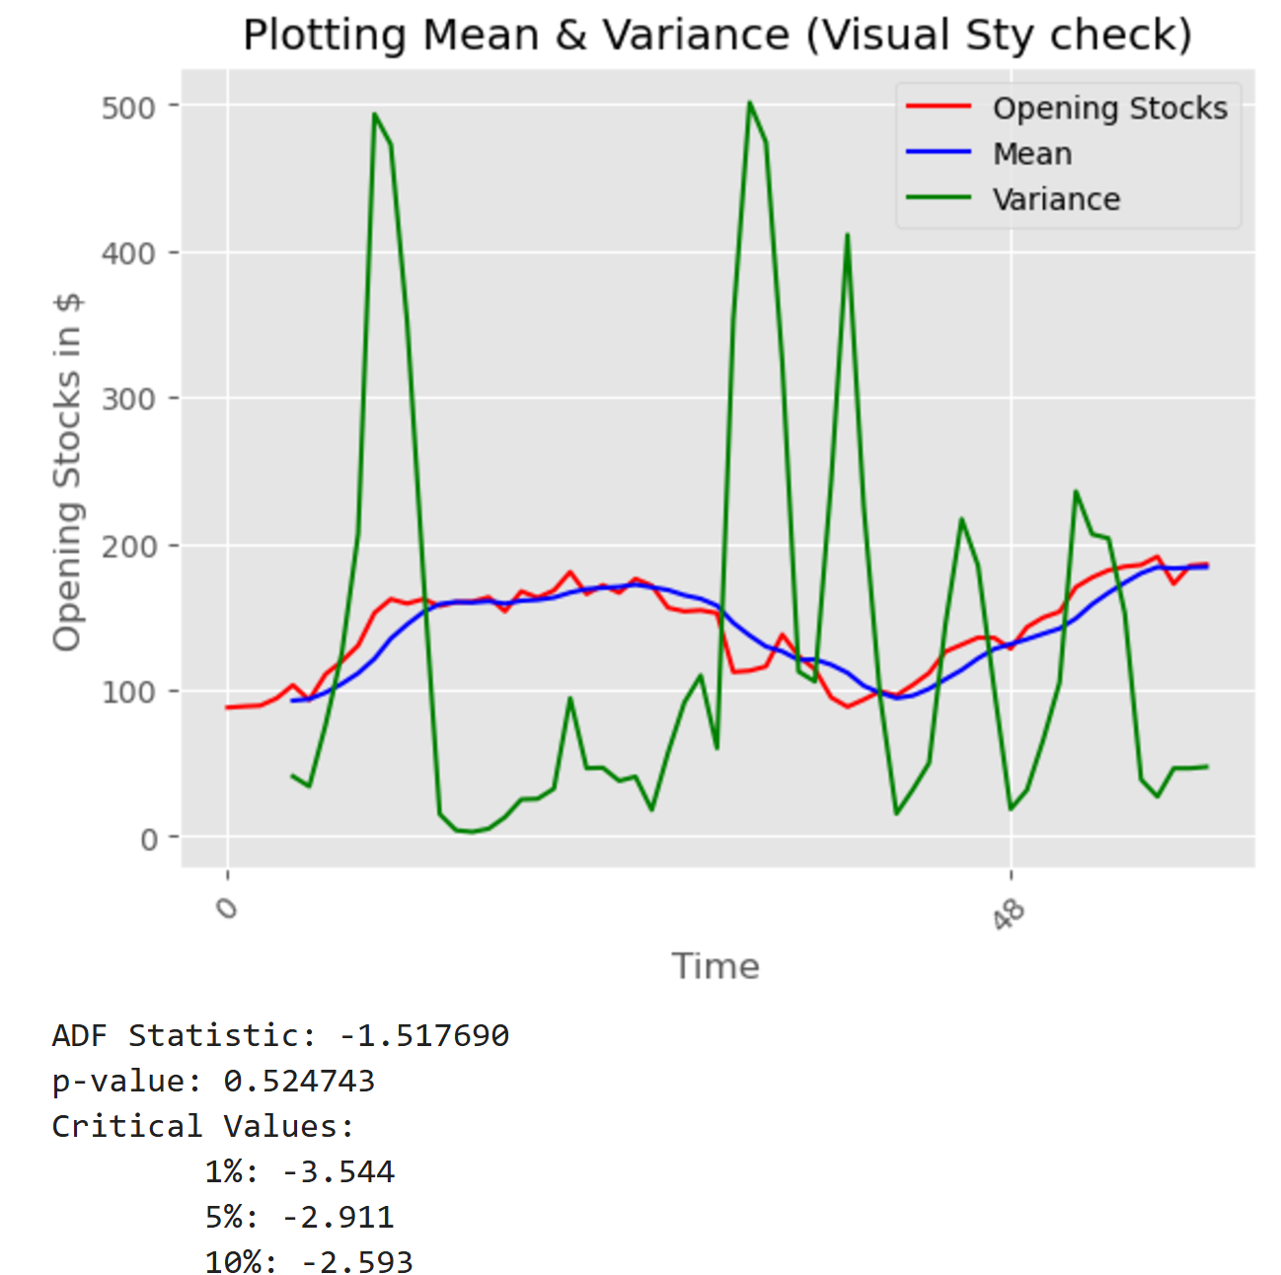
2. Augmented Dickey-Fuller (ADF) Test
The ADF test is a statistical approach that evaluates the presence of unit roots, determining whether a time series is non-stationary.
Null Hypothesis (H₀): p-value > 0.05 → Non-Stationary
Alternative Hypothesis (H₁): p-value < 0.05 → Stationary
Result: The ADF test yields a p-value of 0.5247, which is greater than 0.05, failing to reject the null hypothesis. Thus, the data is confirmed as non-stationary.

Slide 11
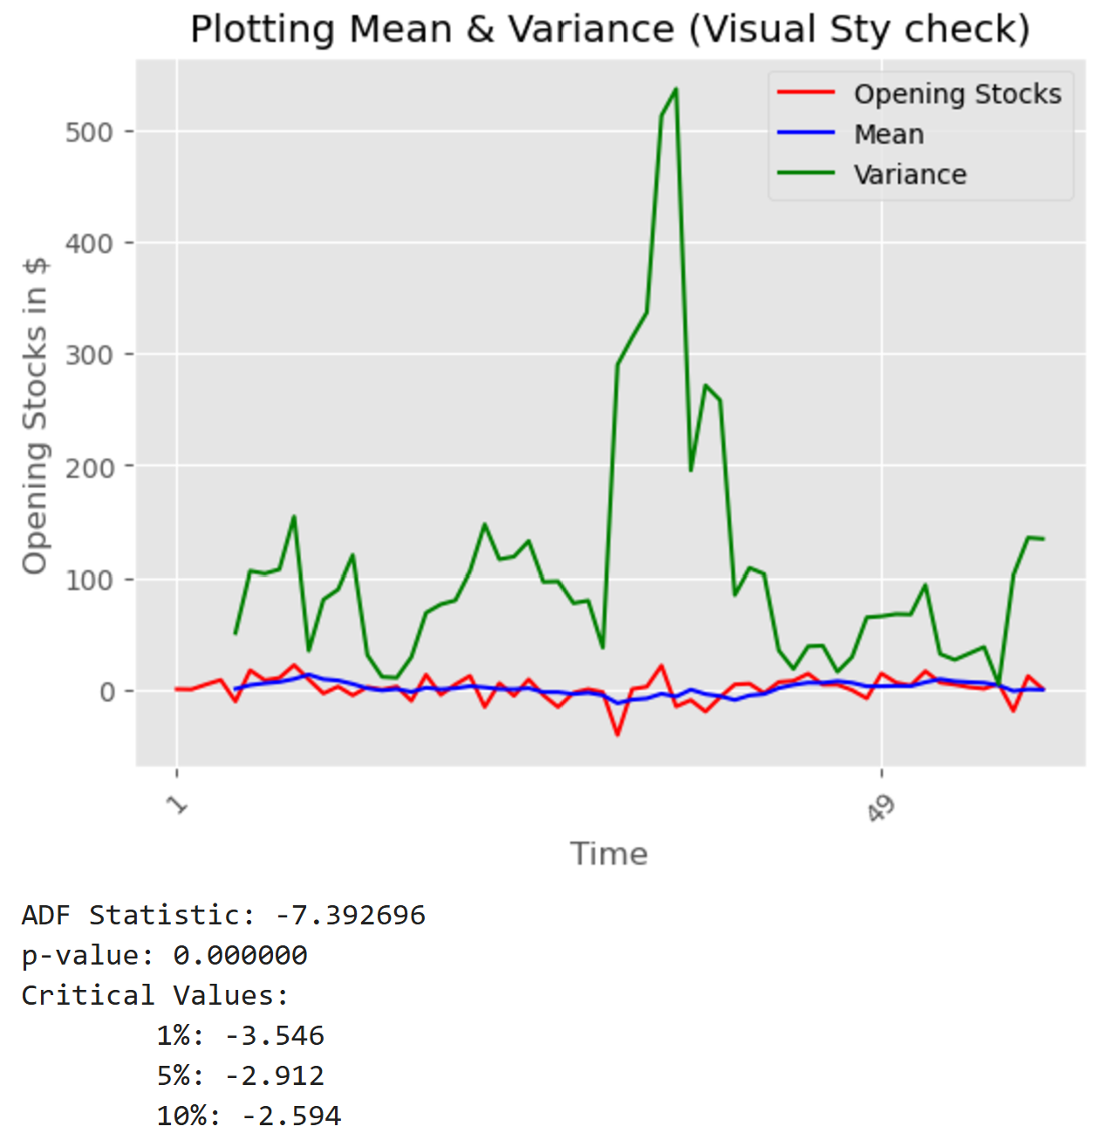
First-Order Differencing:
To handle non-stationarity, first-order differencing is applied. This technique removes trends by computing the difference between consecutive observations.
This results in a new dataset that starts from the second time point (due to differencing), transforming the series into a more stationary form.
Conclusion: After applying differencing, the dataset is expected to achieve stationarity, making it suitable for time series modeling and forecasting.

Slide 12
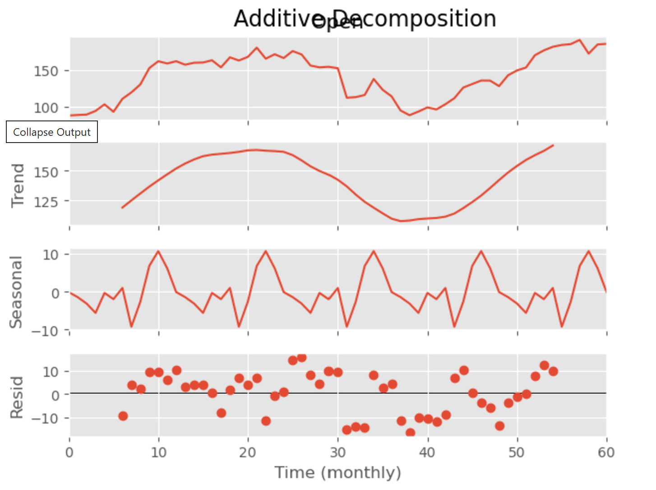
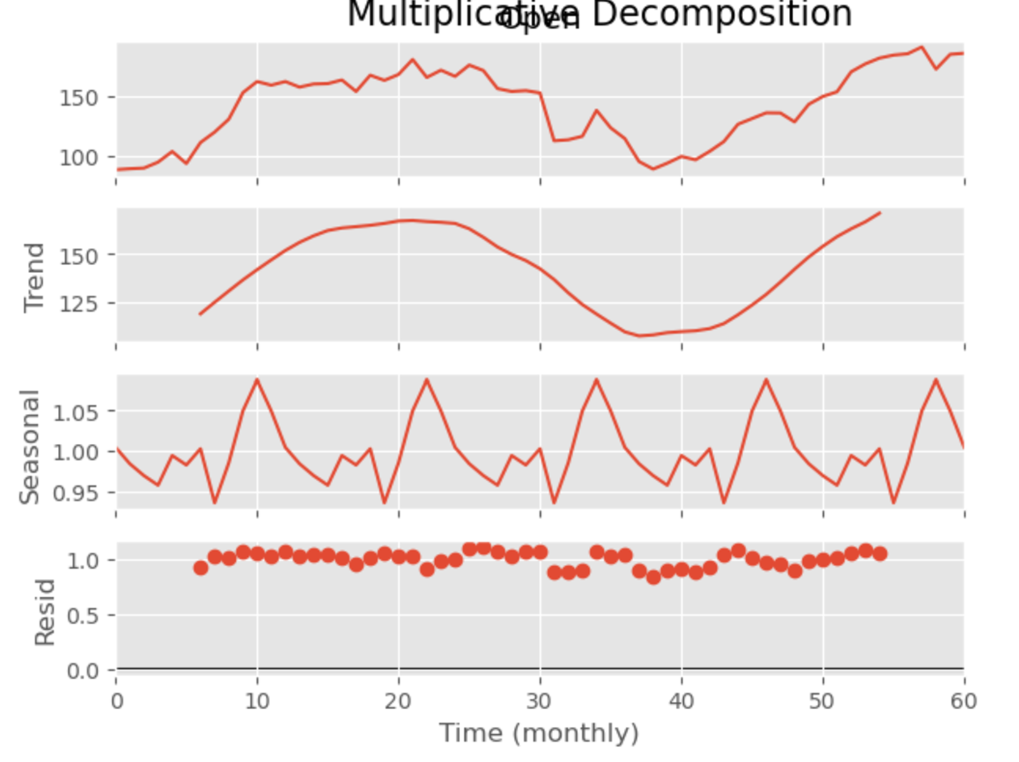
Additive Decomposition
Multiplicative Decomposition
Additively: y(t) = trend + seasonality + residual
Multiplicatively: y(t) = trend * seasonality * residual

Slide 13
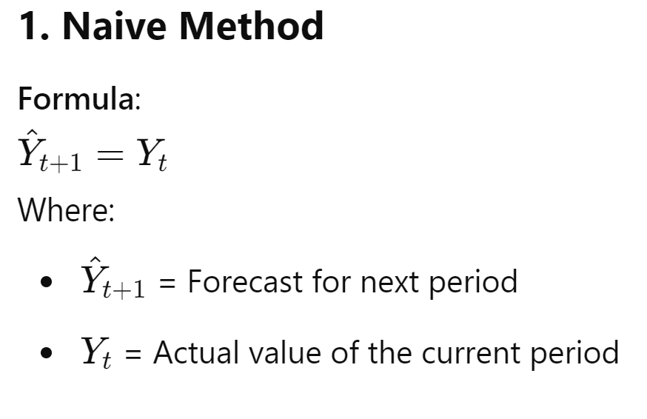
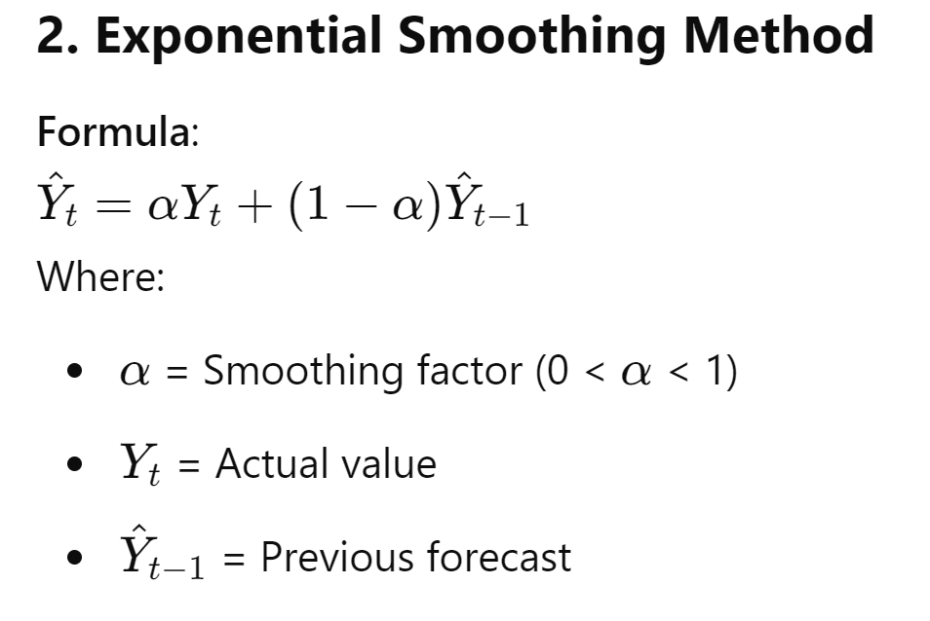
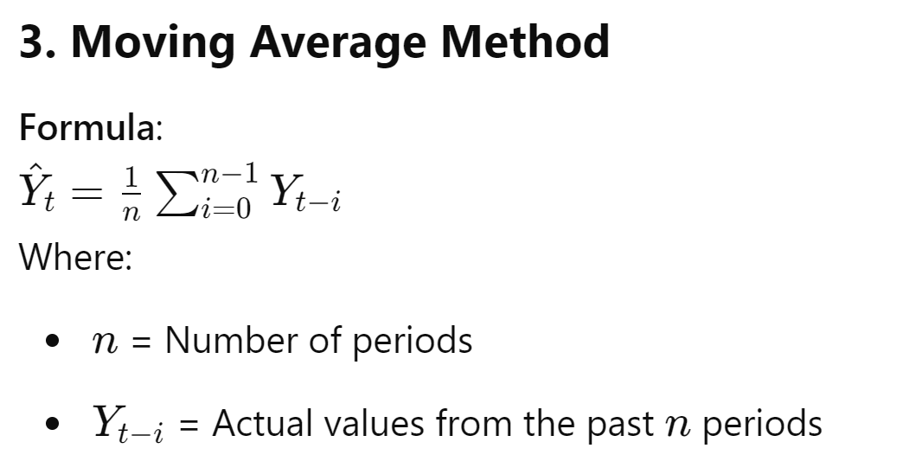

Slide 14
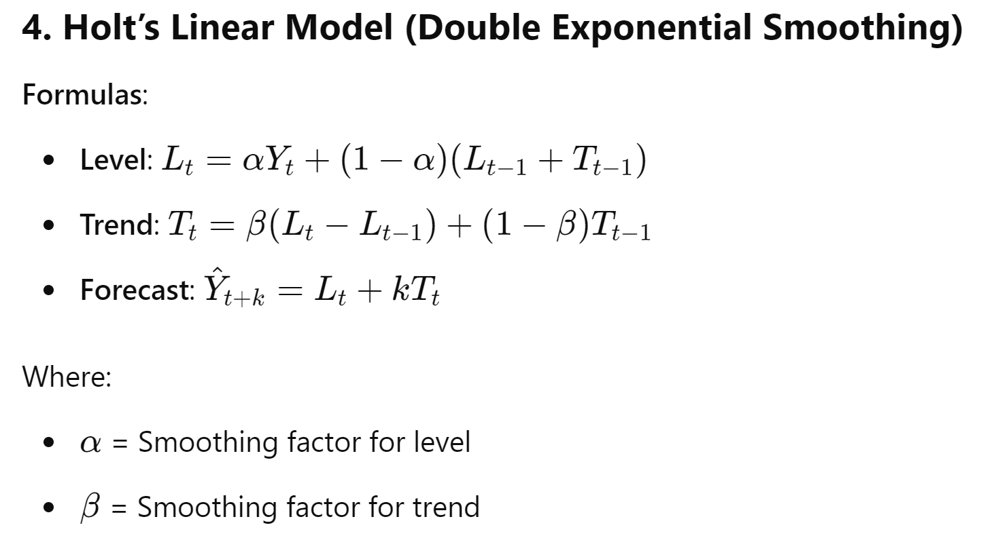
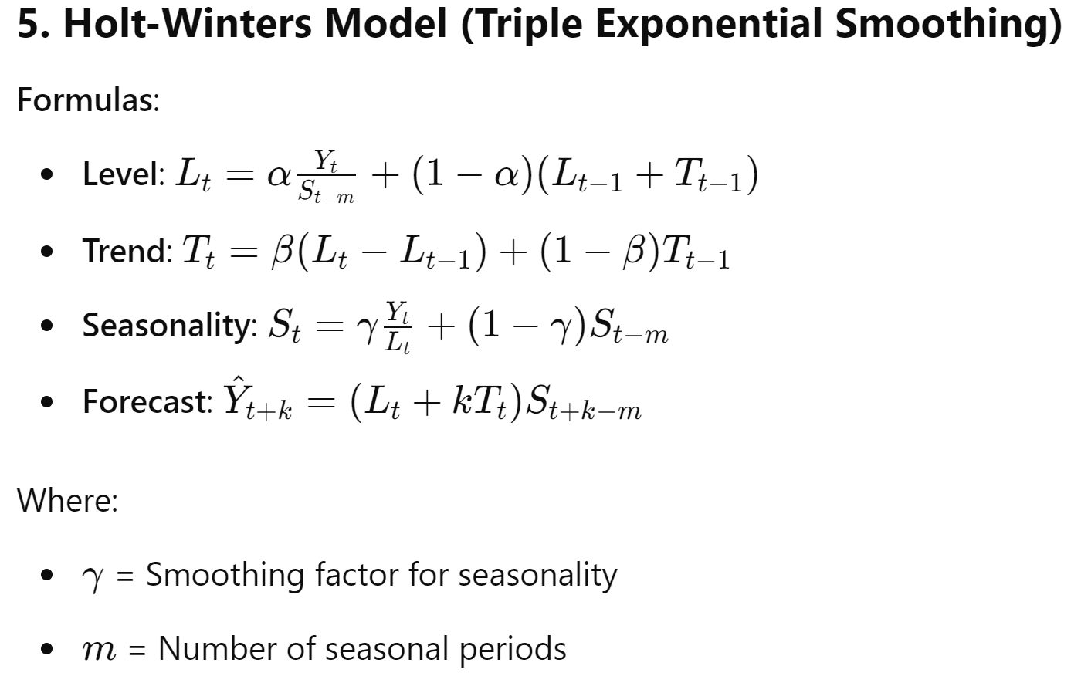

Slide 15
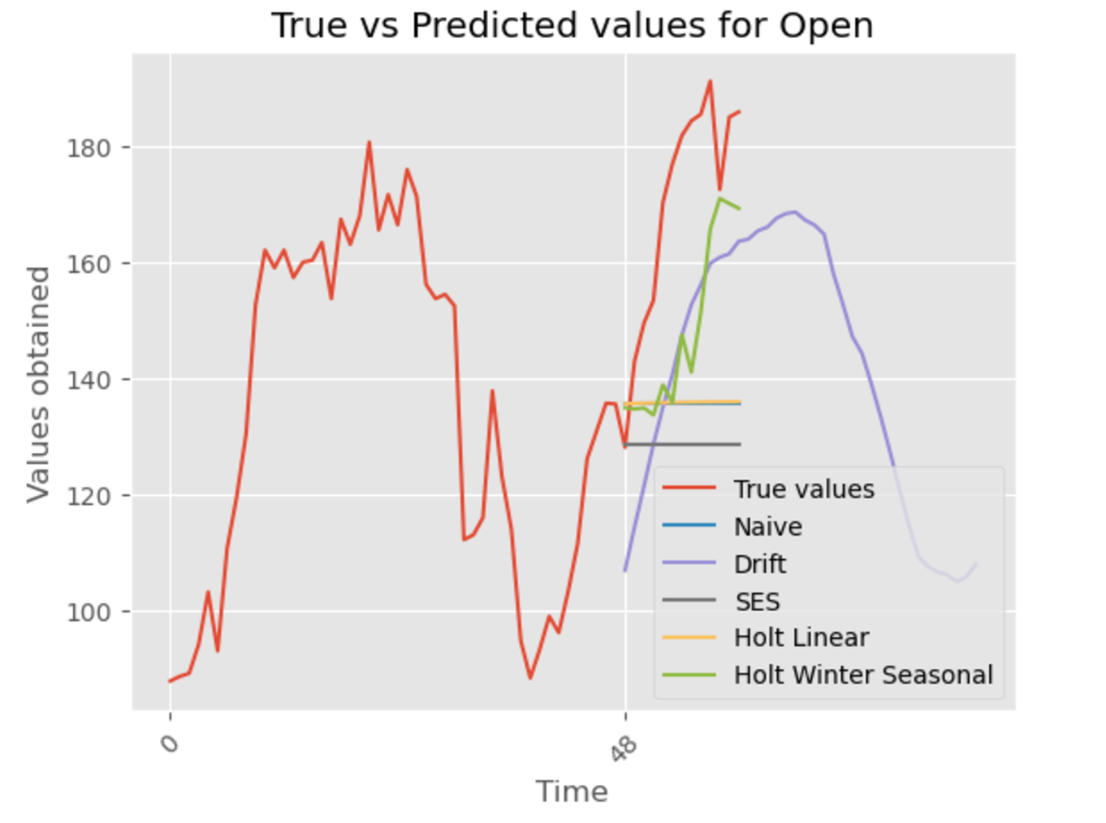

Slide 16
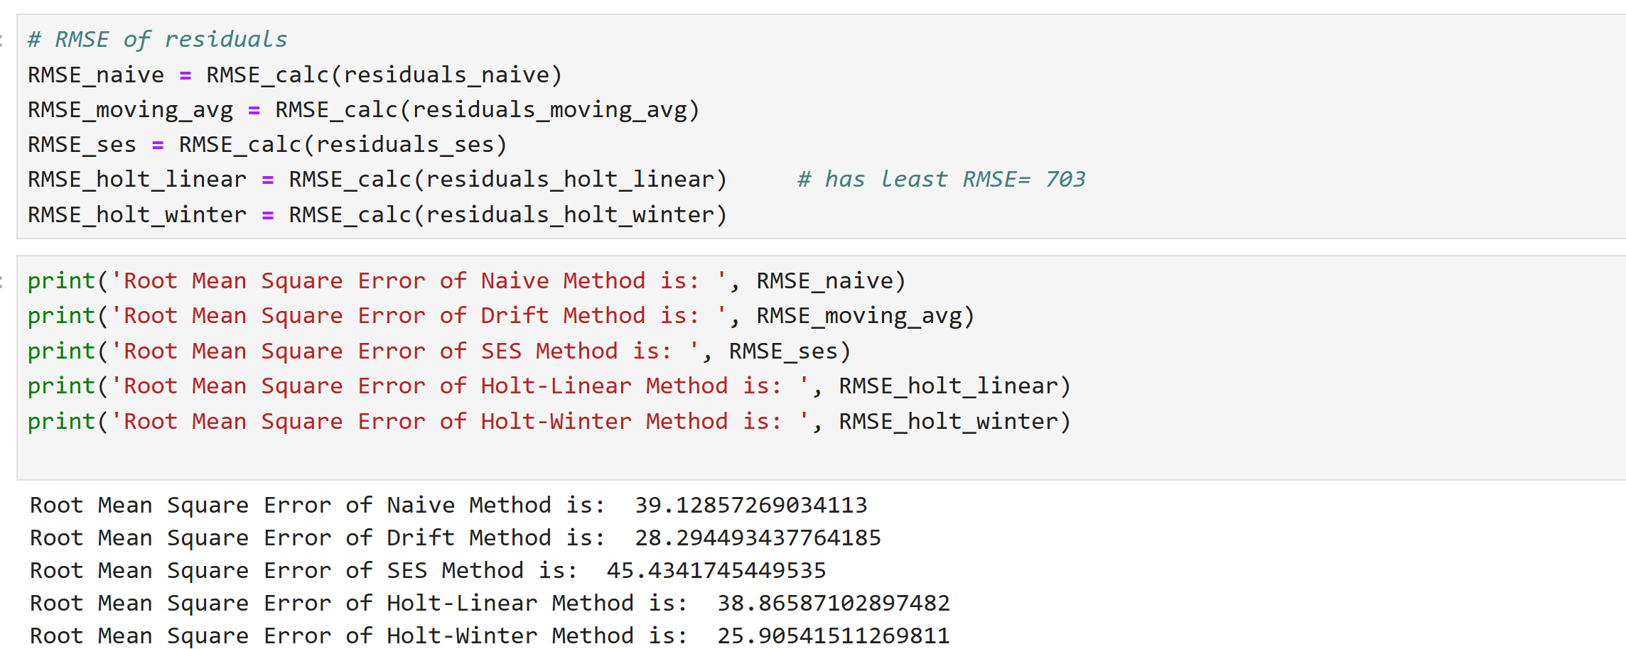
Root mean squared values for each method

Slide 17
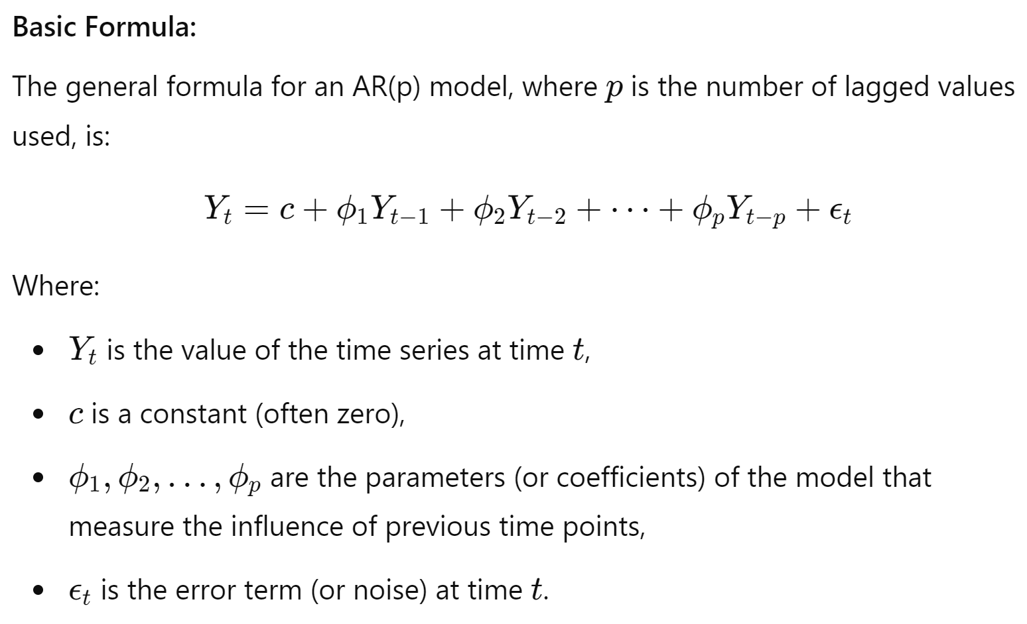
Auto Regressive (AR) model
The Auto Regressive (AR) model is a time series model used for forecasting, where the current value of the series is based on its own previous values. The AR model is widely used in time series analysis and forecasting.

Slide 18
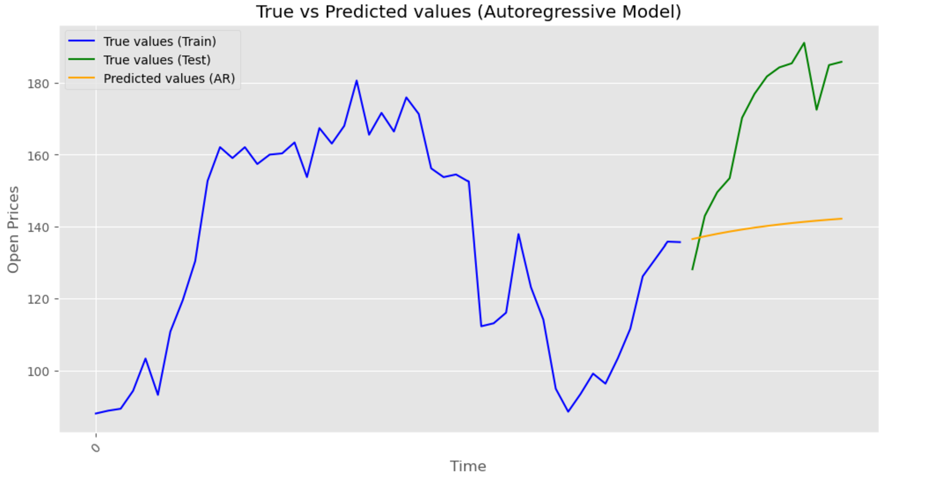
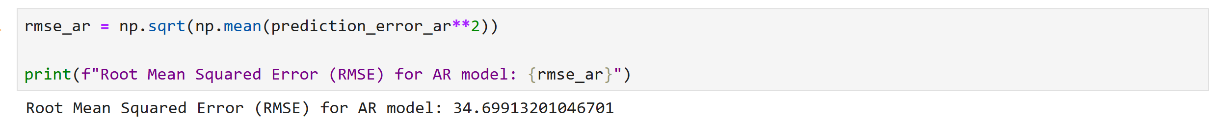
Root mean squared values for auto regression model

Slide 19
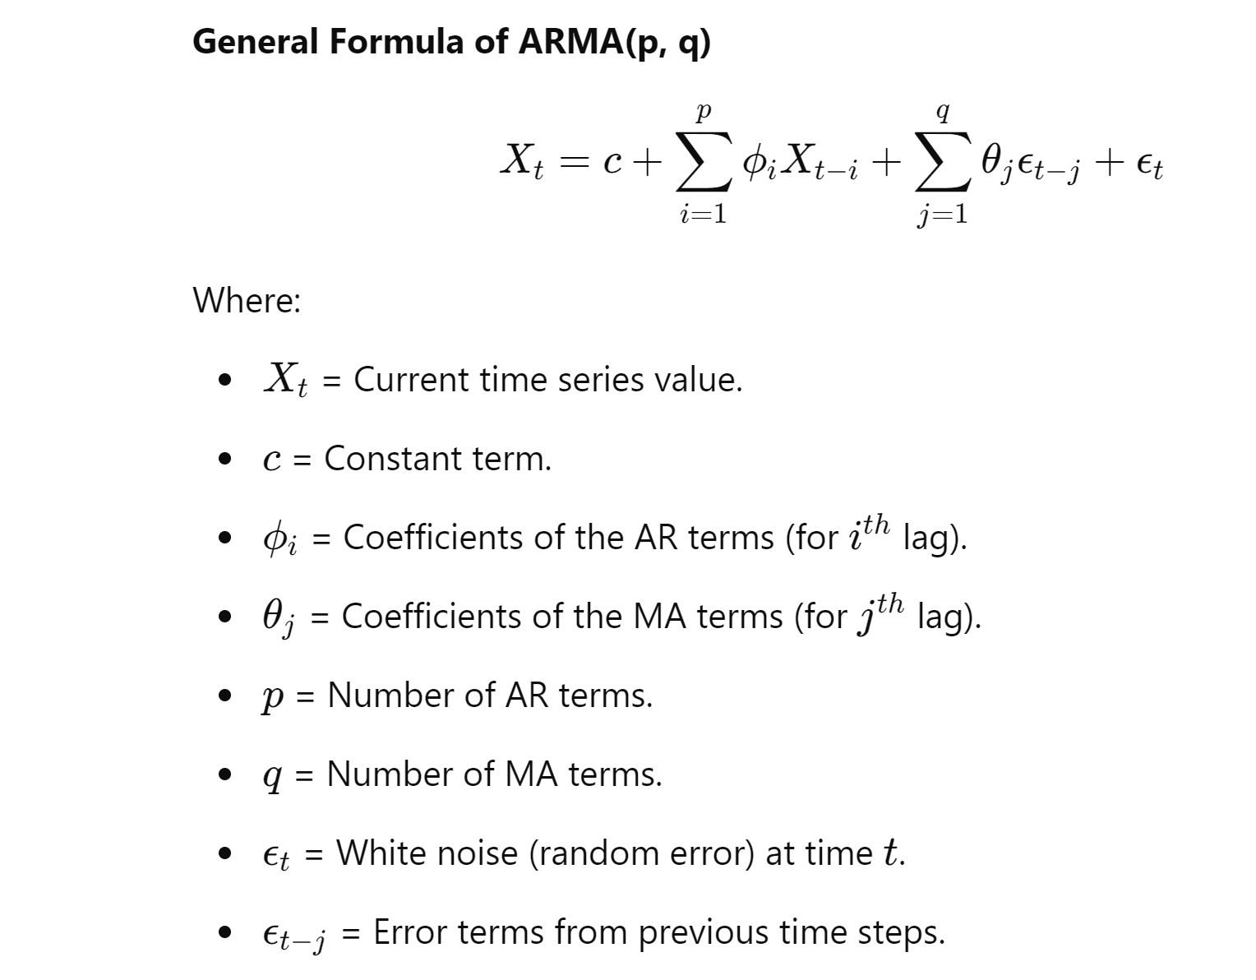
Auto Regressive Moving Average (ARMA) model
An ARMA (AutoRegressive Moving Average) model combines two components:
Autoregressive (AR) Component: It models the relationship between a value and its previous values (lags).
Moving Average (MA) Component: It models the relationship between a value and past forecast errors.

Slide 20
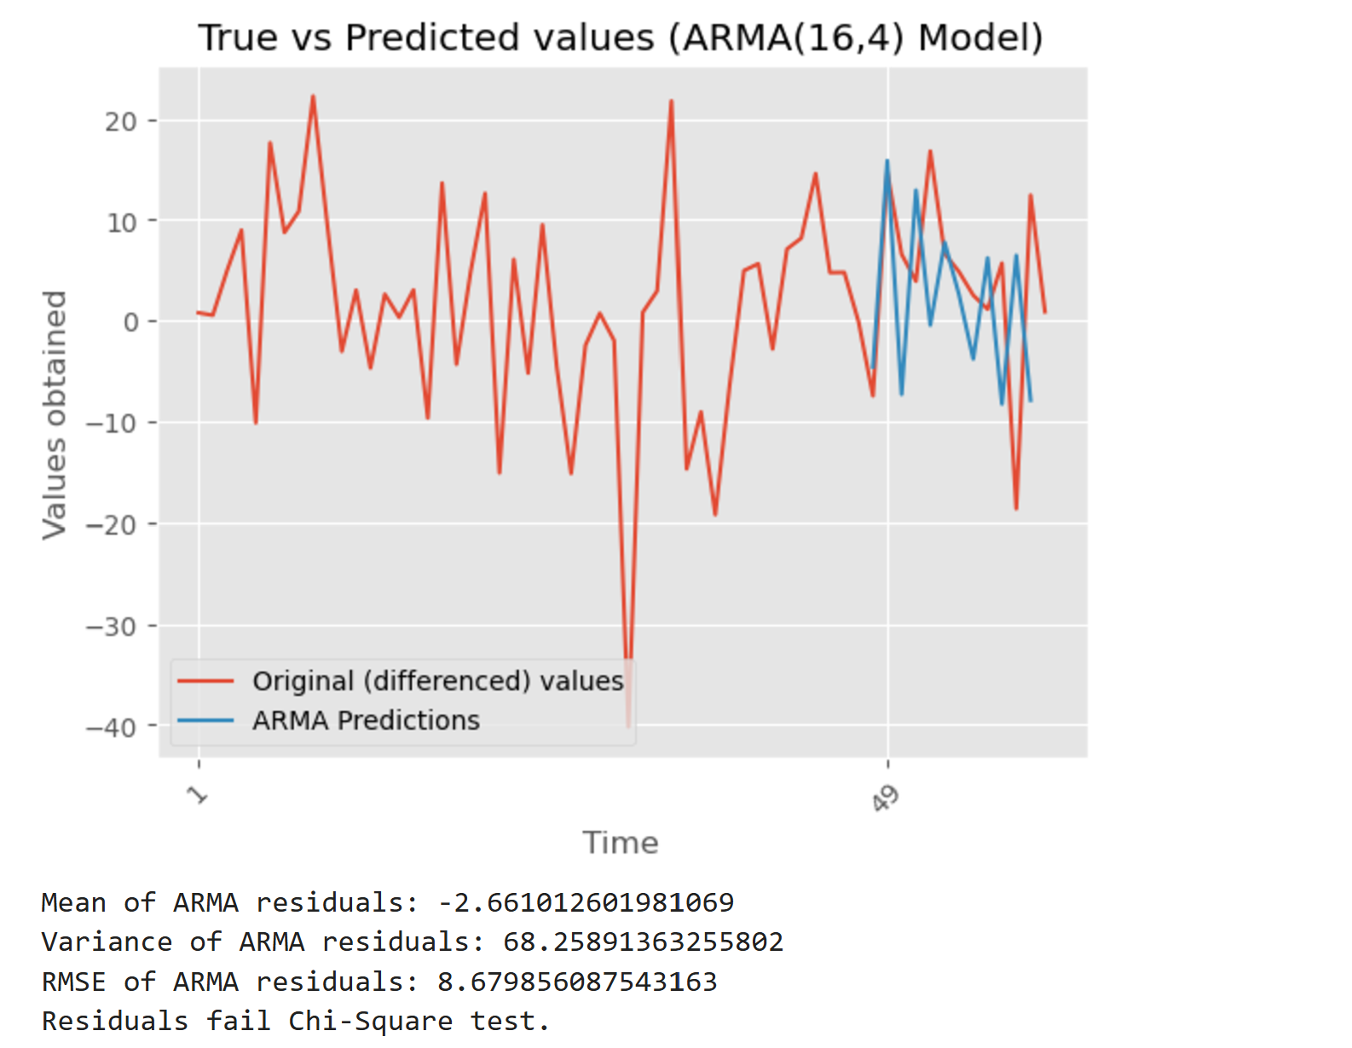
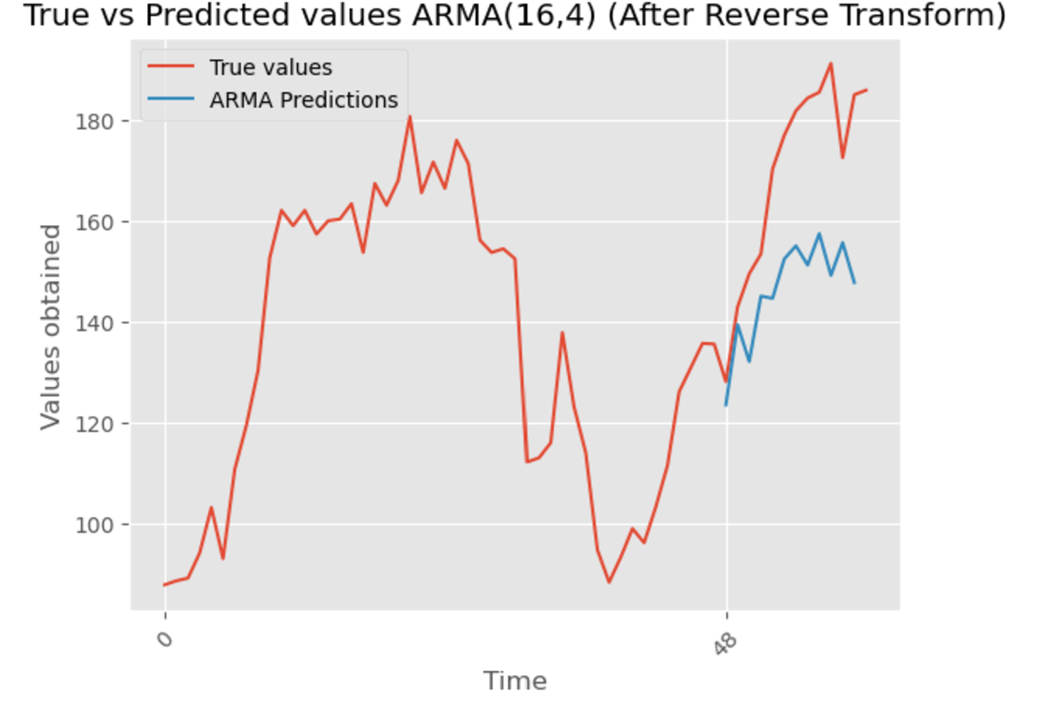

Slide 21
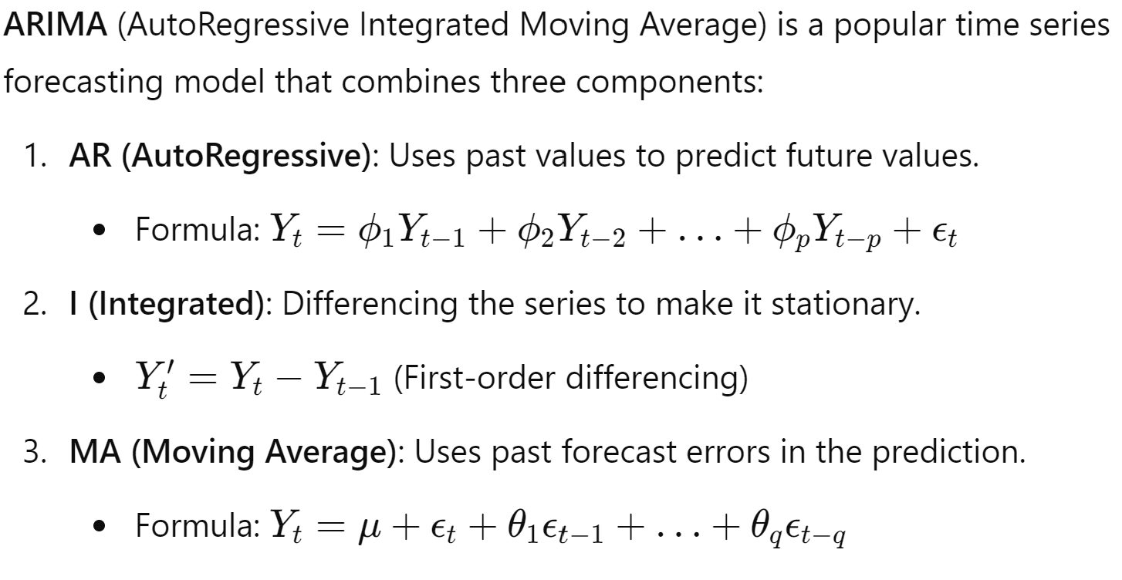
ARIMA model

Slide 22
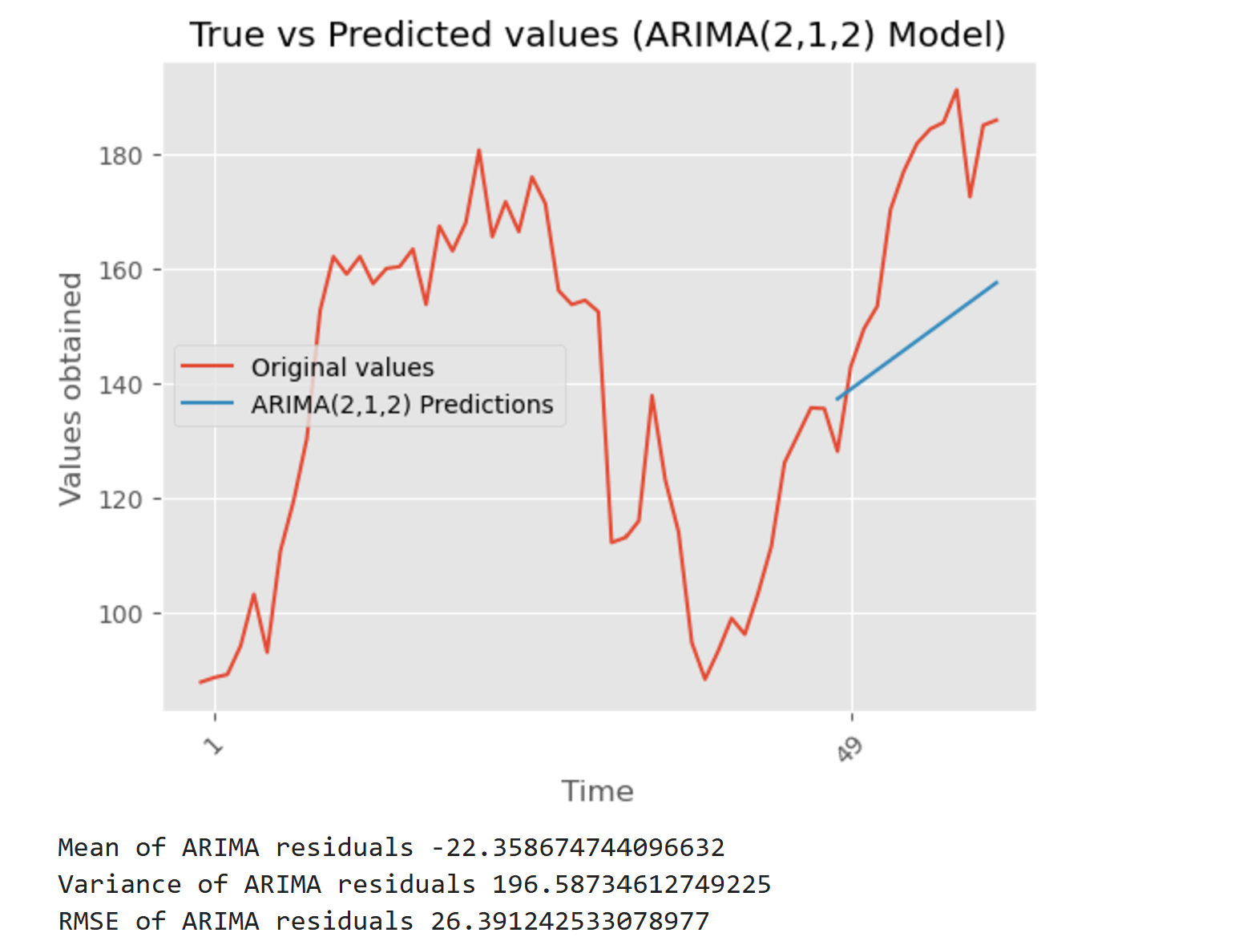
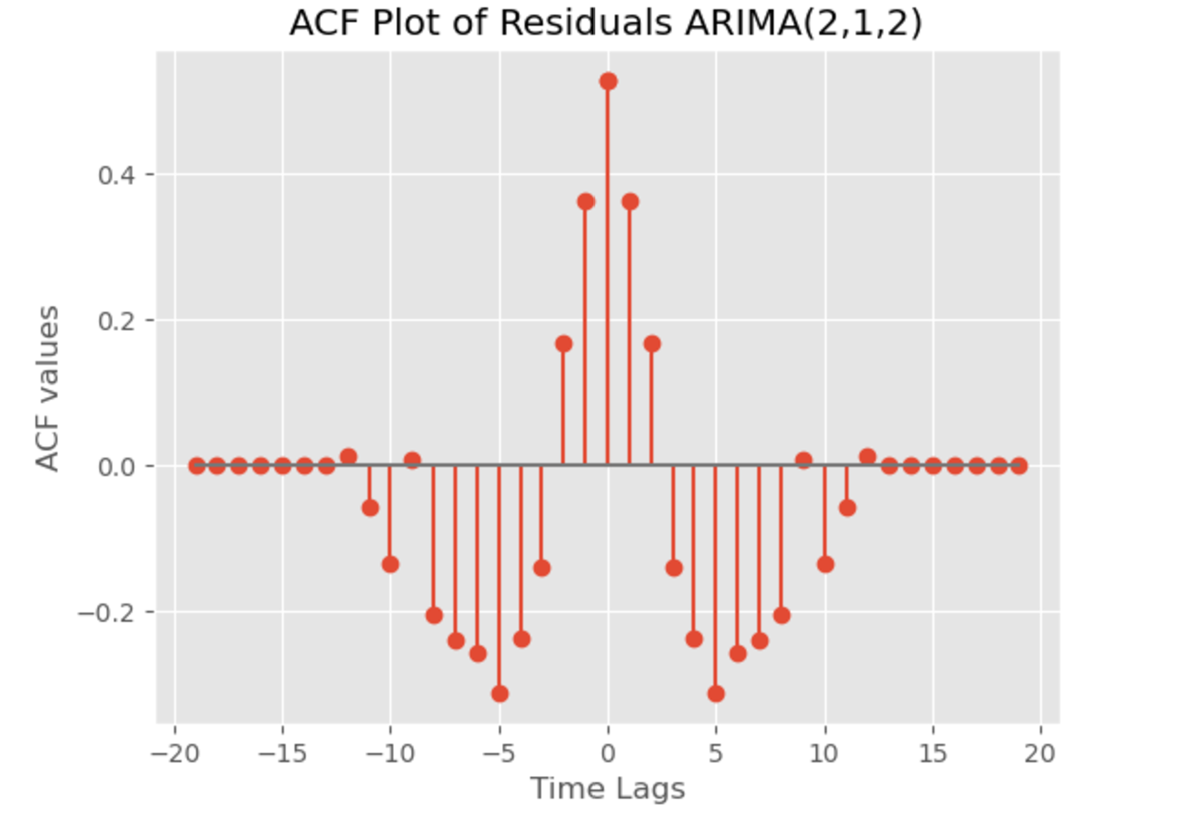

Slide 23
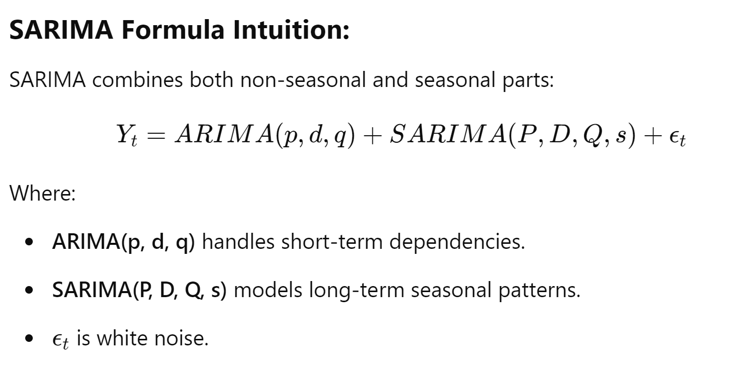
Seasonal AutoRegressive Integrated Moving Average Model
SARIMA is an extension of the ARIMA model that incorporates seasonality into time series forecasting. It is represented as SARIMA(p, d, q)(P, D, Q, s), where:

Slide 24
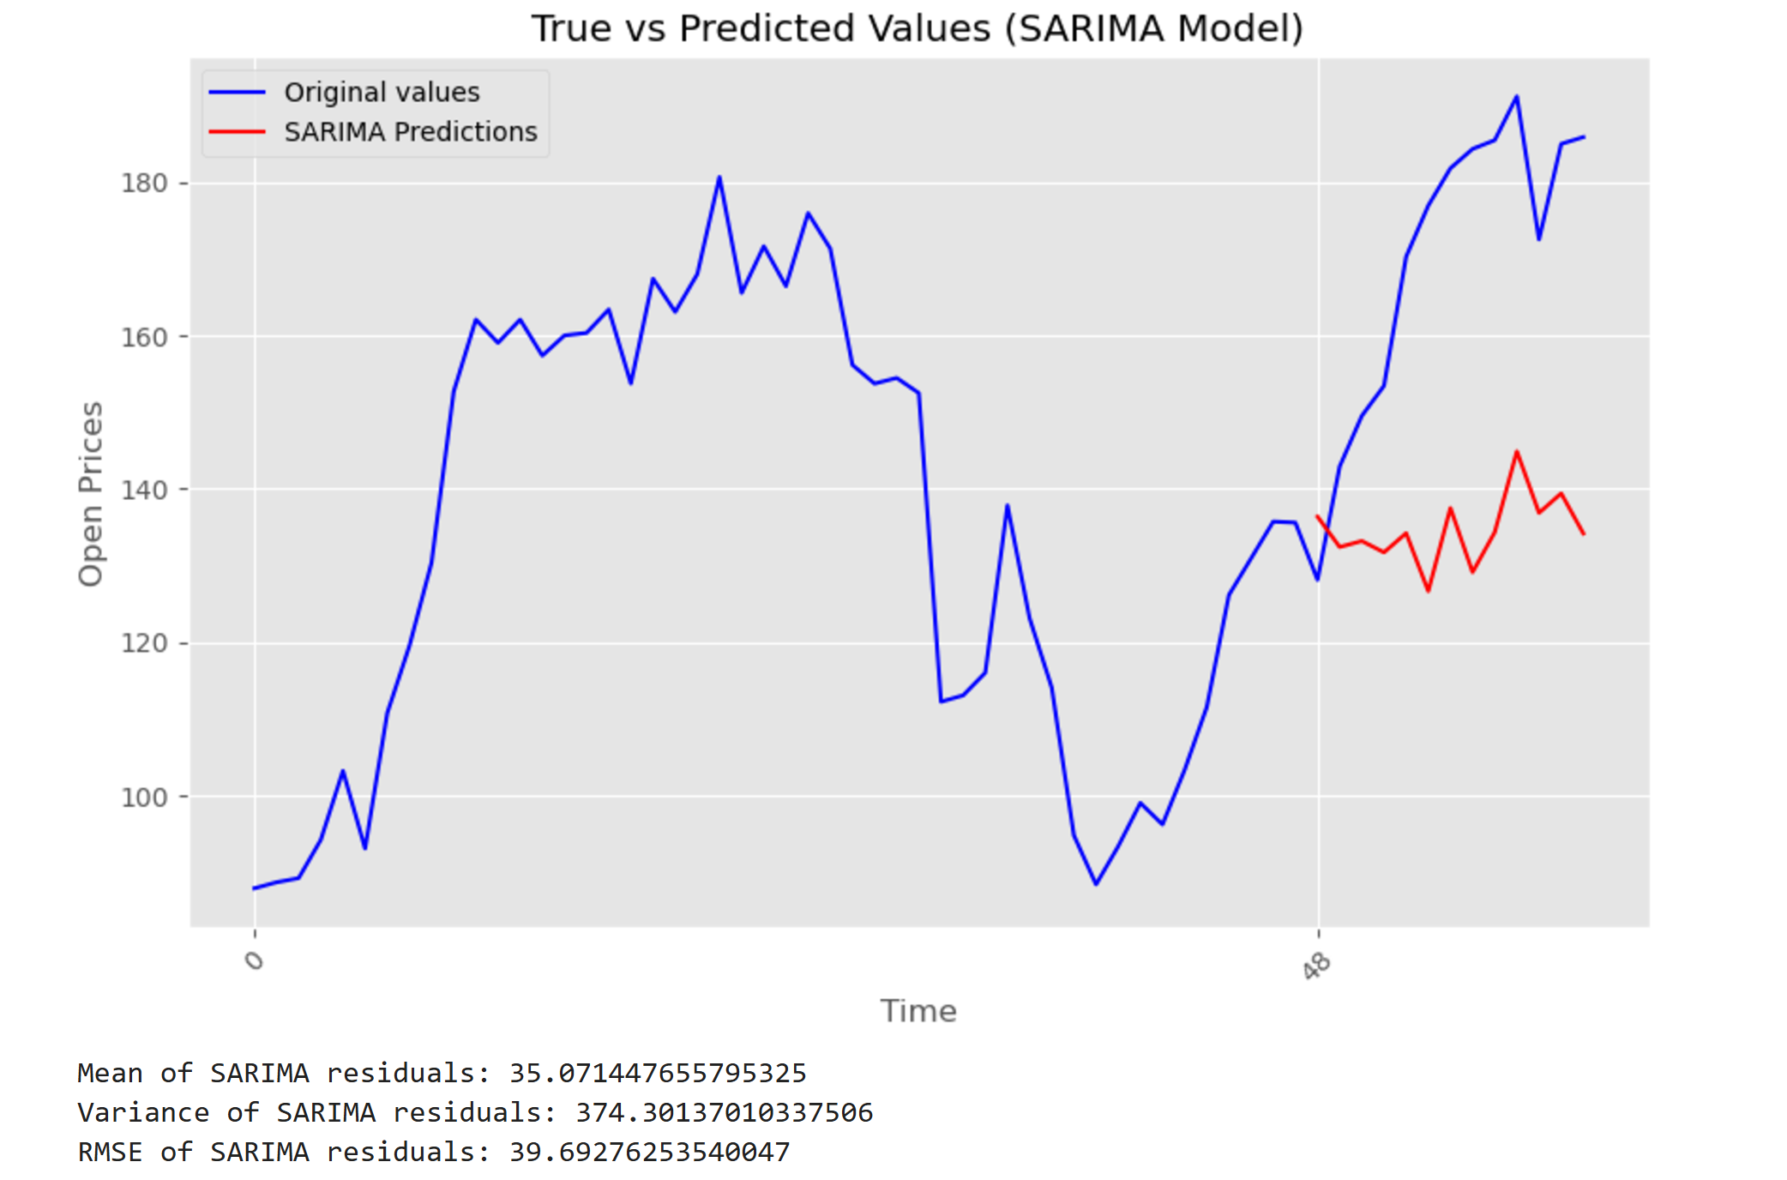

Slide 25
Conclusion:
The ARMA(16,4) model, with 16 autoregressive terms and 4 moving average terms, successfully captured both the trend and noise components of the stock prices, making it the best performer in terms of minimizing Root Mean Squared Error (RMSE) and improving predictive accuracy over the test set.
In conclusion, the ARMA(16,4) model outperformed other methods in terms of prediction accuracy for Amazon's opening stock prices, making it the best choice for this time series forecasting task.
Reference:
Introduction to time series forecasting with python, by Jason brownlee.
Time Series Data: https://www.nseindia.com/

Slide 26
Thank you

